Slide 1
Can I Beat The Bookies?
Nick Campanelli

Slide 2
Goal: To use machine learning to predict results in the English Premier League and inform a betting strategy.
Why: Sports betting, particularly on soccer, offers a chance to make some significant money. With lots of companies competing and offering attractive odds, an informed betting strategy may effectively net a profit.
How: Using my domain knowledge as a soccer fan to construct informative features from the all time history of the English Premier League.

Slide 3

Why the English Premier League?

Slide 4
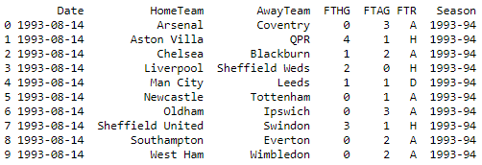
Data
EPL Results 1993-2018
https://www.kaggle.com/thefc17/epl-results-19932018/version/1
Results from seasons 1993/94 - 2017/18
EPL Betting Odds
http://www.football-data.co.uk/englandm.php
Standings for seasons 1994/95 - 2016-17

Slide 5
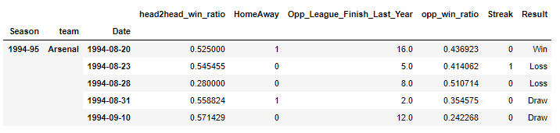
Data Cleaning
Drop unnecessary information
Duplicate and organize the dataframe - index by Season/Team/Date
Use domain knowledge to add features and merge data from league standings CSV

Slide 6
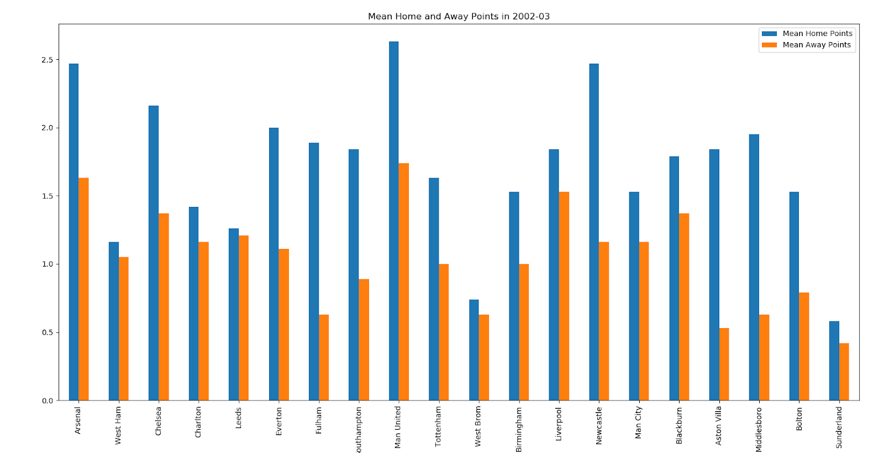
Home or Away?

Slide 7
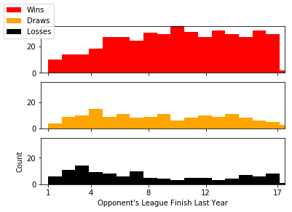
Opponent’s League Finish Last Year
(Manchester United)

Slide 8
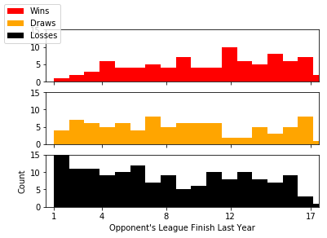
Opponent’s League Finish Last Year
(Leicester City)

Slide 9
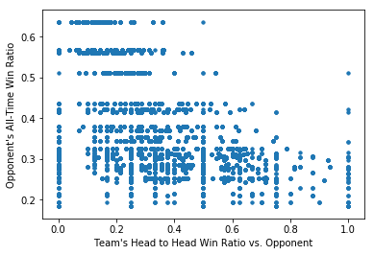
Collinearity?

Slide 10
Multinomial Logistic Regression
Features: head to head win ratio, home or away, opponent’s league finish last year, opponent’s all time win ratio, and win streak
Target: Result in three classes. Win, loss, or draw.
Training set: Seasons from 1994-95 through 2015-16
Testing set: 2016-17 season
Parameters: C = 0.1

Slide 11
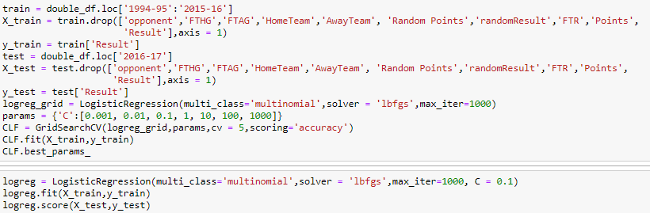


Classification Report and Model Coefficients
head to head win ratio, home or away, opponent’s league finish last year, opponent’s all time win ratio, win streak

Slide 12
Random Forest Classifier
Features: head to head win ratio, home or away, opponent’s league finish last year, opponent’s all time win ratio, and win streak
Target: Result in three classes. Win, loss, or draw.
Training set: Seasons from 1994-95 through 2015-16
Testing set: 2016-17 season
Parameters: n_estimators = 250, max_depth = 7, max_features = sqrt

Slide 13
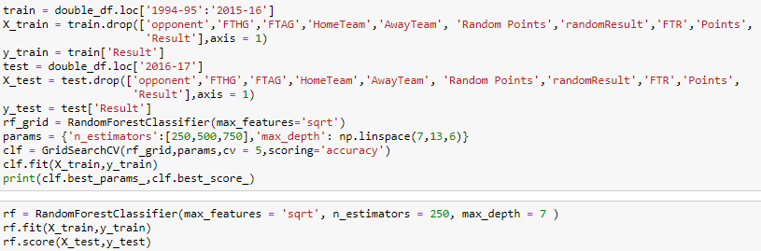


Slide 14
What’s Important: A Better Model?
Precision, precision, precision!
Can it go higher?
Logistic Regression is faster, more interpretable and performs better!
Model with only the most consistent teams?
Model with only two classes?
Draws are poorly predicted!

Slide 15
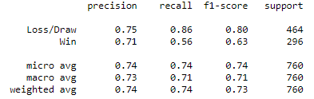
Two Class Logistic Regression

Slide 16

Using my Model to Place Bets
Betting odds gathered from Bet365
Betting strategy:
Only bet on predicted wins
Place $100 wager per bet

Slide 17
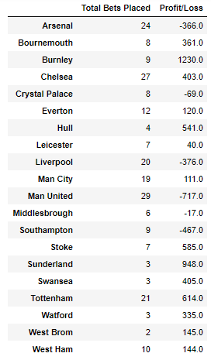
Betting Results
Total bets: 231
Total investment of all bets: $25,410
Total return: $29,380
Total profit: $3,970
ROI: 15.5% in a 9 month timeframe!
Without betting on the big teams, total profit is $5,137 on 131 bets!

Slide 18
Conclusions
Results can be improved with better odds
Betting threshold?
Simplistic models with a well defined use case can be quite effective!
Logistic Regression vs. Random Forest Classifier
Should I use this model to actually bet on the Premier League?
Would more features be useful?
Money spent?
Goals for/against?
Weather?
Is this model generalizable?
Questions?

